Slide 1

CSCI 232: Data Structures and Algorithms
Greedy Algorithms + Tractability
Reese Pearsall
Spring 2024
https://www.cs.montana.edu/pearsall/classes/spring2024/232/main.html
1

Slide 2
Announcements
Lab 12 due Sunday at 11:59 PM
2

Slide 3

Greedy Algorithms
Technique to solve a problem that involves making the choice the best helps some objective
Objective = shortest cost, most profit, spend least money as possible
We (usually) do not look ahead, plan, or revisit past decisions
Hope that optimal local choices lead to optimal global solutions
Sometimes the greedy approach is not the best solution a problem
3

Slide 4
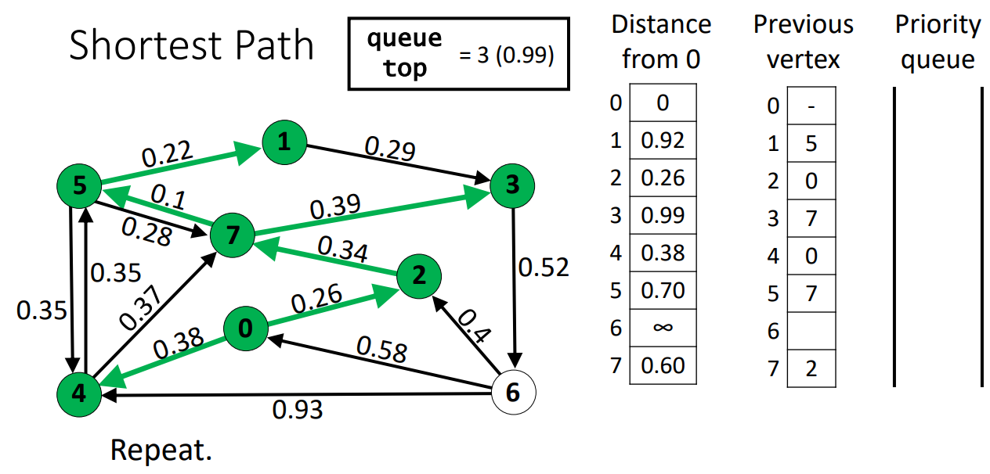
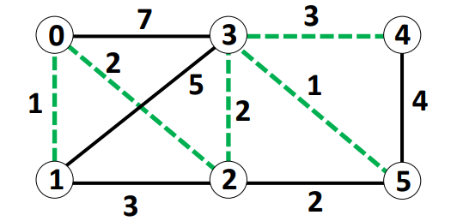
Greedy Algorithms
Running time O(|E|log|E|)
Running time O(|E|*log|V|)
Kruskal’s and Dijkstra’s algorithm are both examples of greedy algorithms
At each step of the algorithm, they attempt to select the edge with the minimum cost
(The greedy approach works fine for these, because these algorithms always return the optimal result)
4

Slide 5
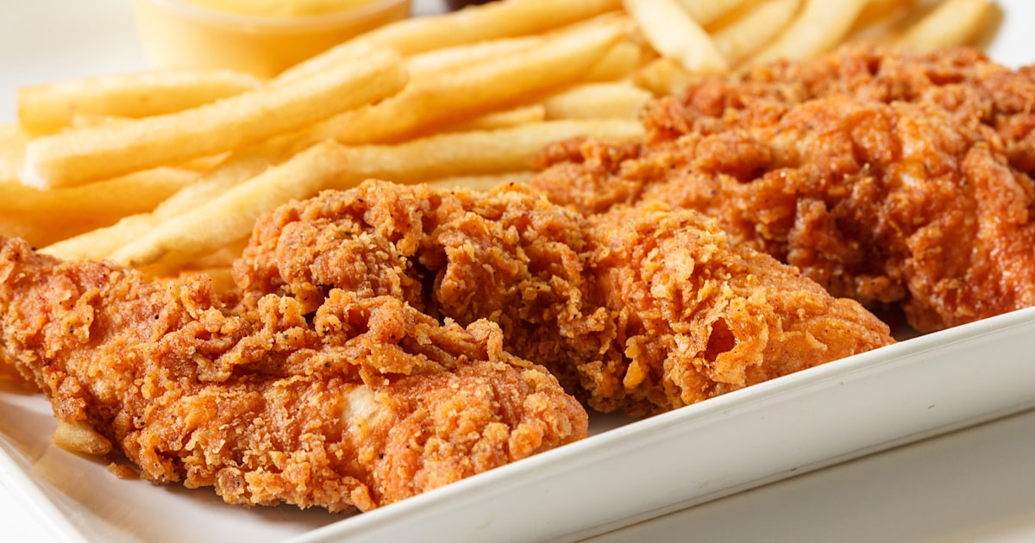
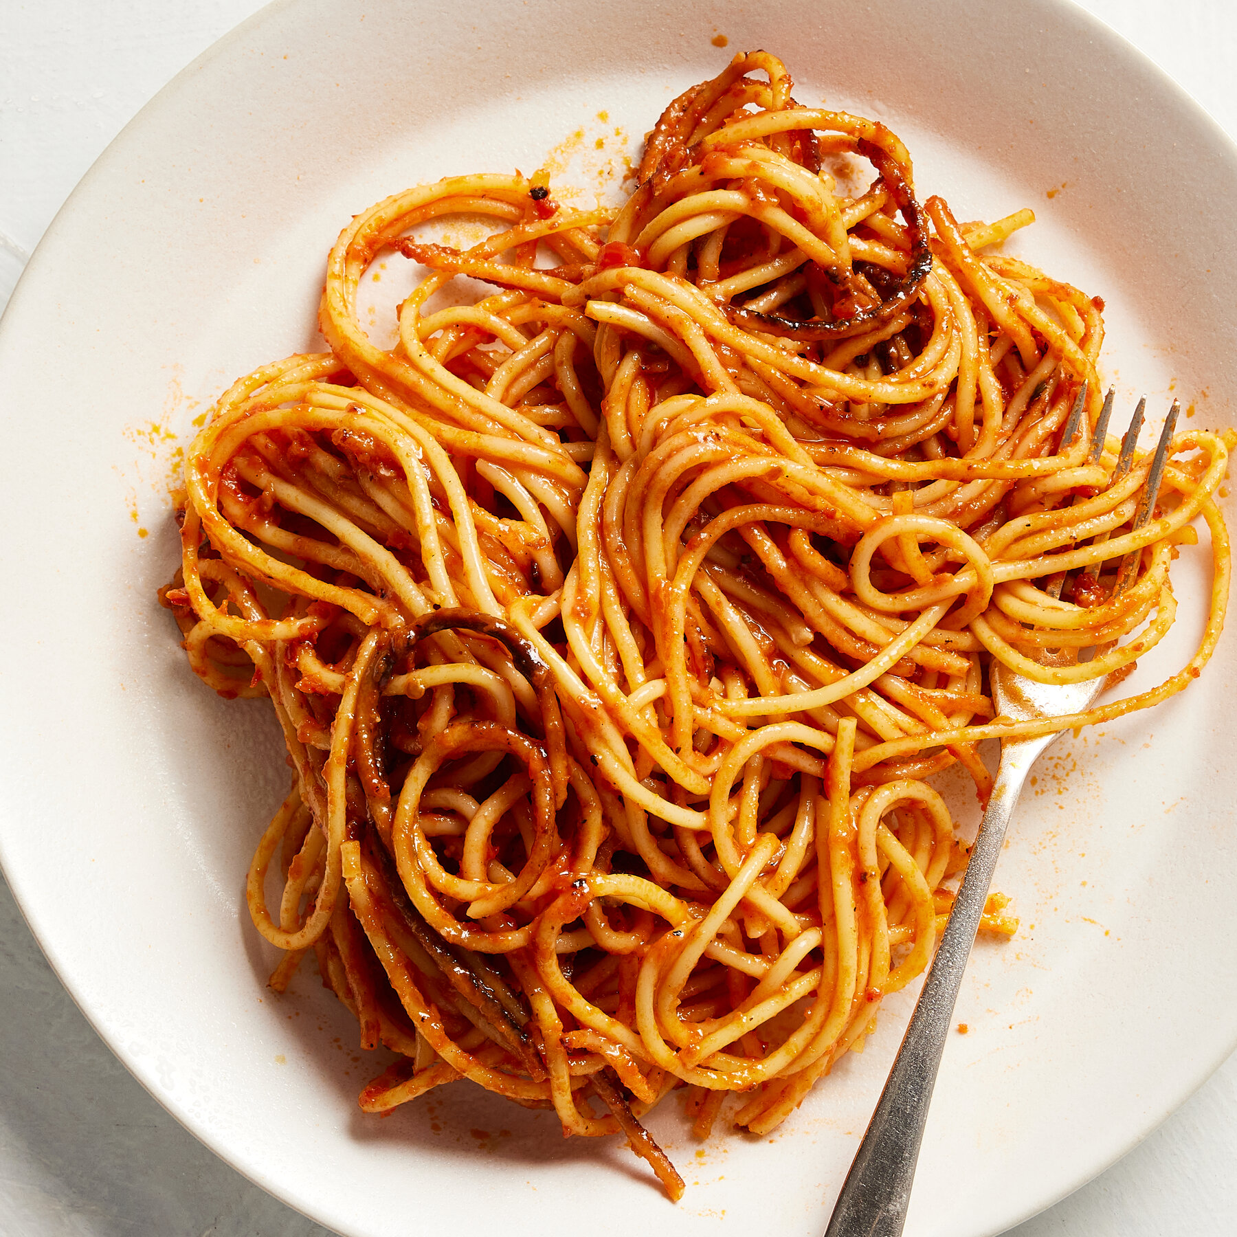
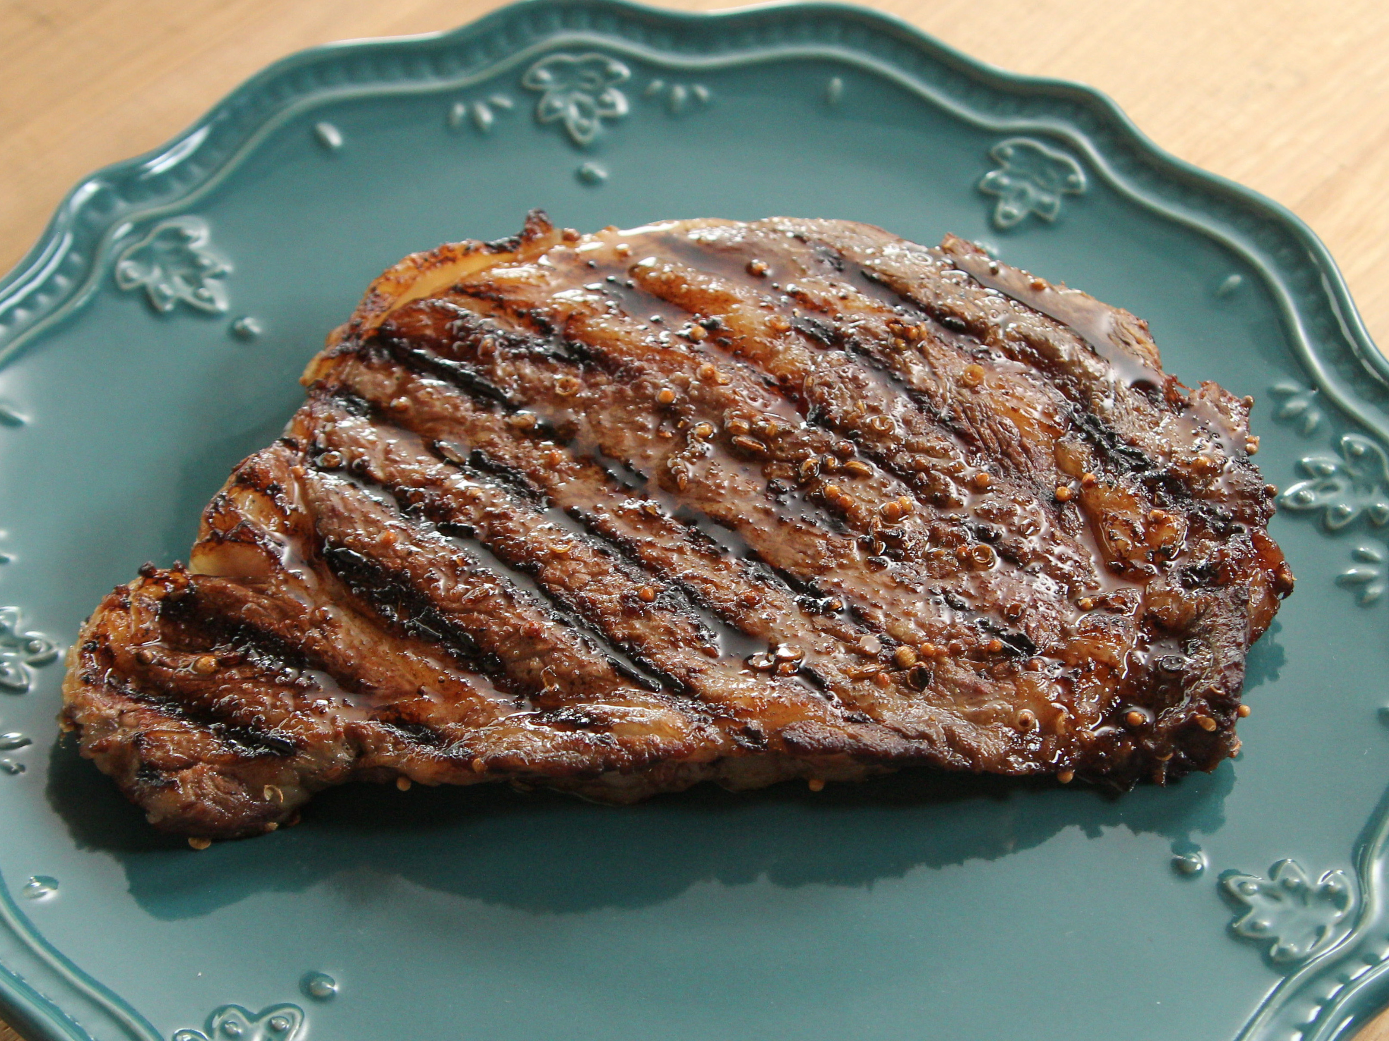
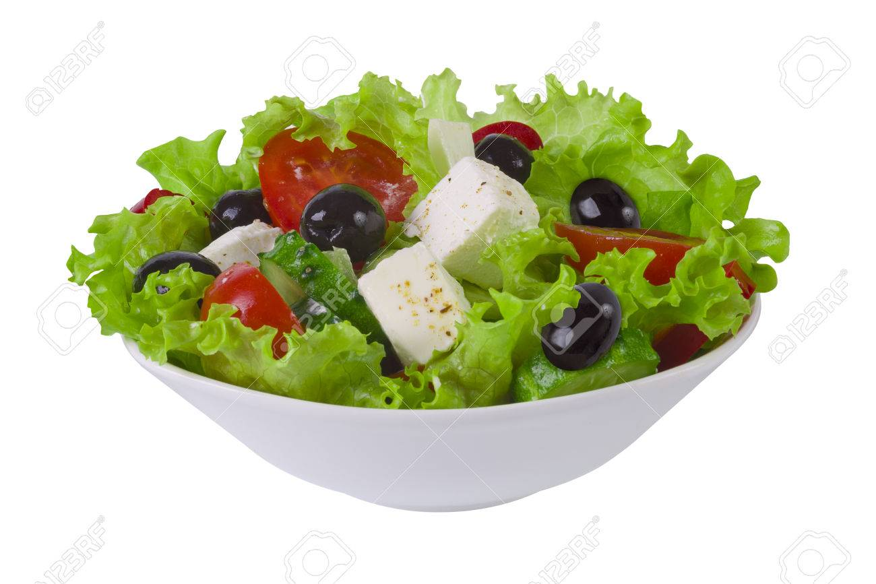
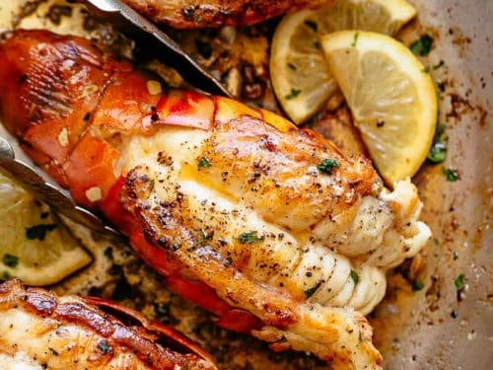
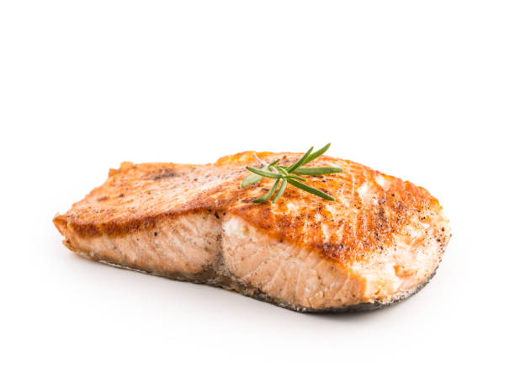
Eating at a Buffet
Suppose you pay D dollars to enter a buffer. You can eat only N items before you get full. You know the cost of every item in the buffet
$31
$11
$16
$18
$23
$40
Our goal is to get the most “bang for our buck”,
aka. maximize
C = (D – S) where S is the sum of the N items we ate at the buffet
5

Slide 6
Eating at a Buffet
Suppose you pay D dollars to enter a buffer. You can eat only N items before you get full. You know the cost of every item in the buffet
$31
$11
$16
$18
$23
$40
Our goal is to get the most “bang for our buck”,
aka. maximize
C = (D – S) where S is the sum of the N items we ate at the buffet
Ideas?
6

Slide 7
Eating at a Buffet
Suppose you pay D dollars to enter a buffer. You can eat only N items before you get full. You know the cost of every item in the buffet
$40
$31
$23
$18
$16
$11
Our goal is to get the most “bang for our buck”,
aka. maximize
C = (D – S) where S is the sum of the N items we ate at the buffet
Sort items by their value
(greatest-to-least)
7

Slide 8
Eating at a Buffet
Suppose you pay D dollars to enter a buffer. You can eat only N items before you get full. You know the cost of every item in the buffet
$40
$31
$23
$18
$16
$11
Our goal is to get the most “bang for our buck”,
aka. maximize
C = (D – S) where S is the sum of the N items we ate at the buffet
Sort items by their value
(greatest-to-least)
2. Select the first N items in the list
N = 3, S = $94, D = $40, C = $54
8

Slide 9
Knapsack Problem
You are a thief with a knapsack that can hold up to N weight. You are robbing a store, where each item has a weight, and a value
Goal: Maximize value of items being stolen, and don’t overfill knapsack
9

Slide 10
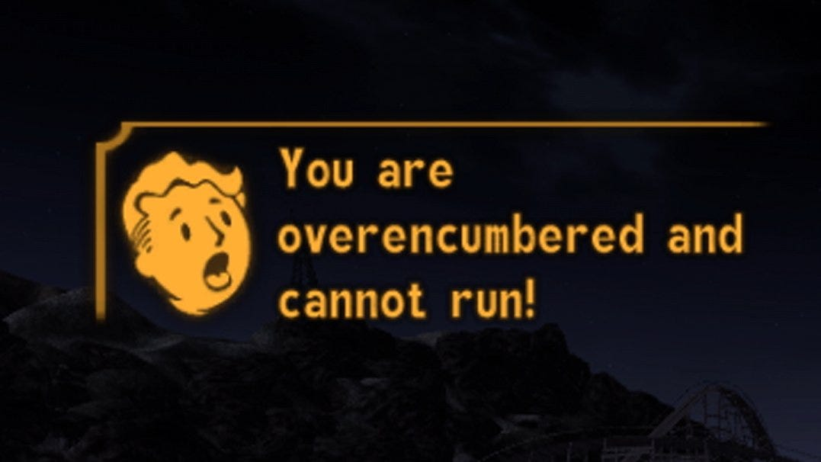

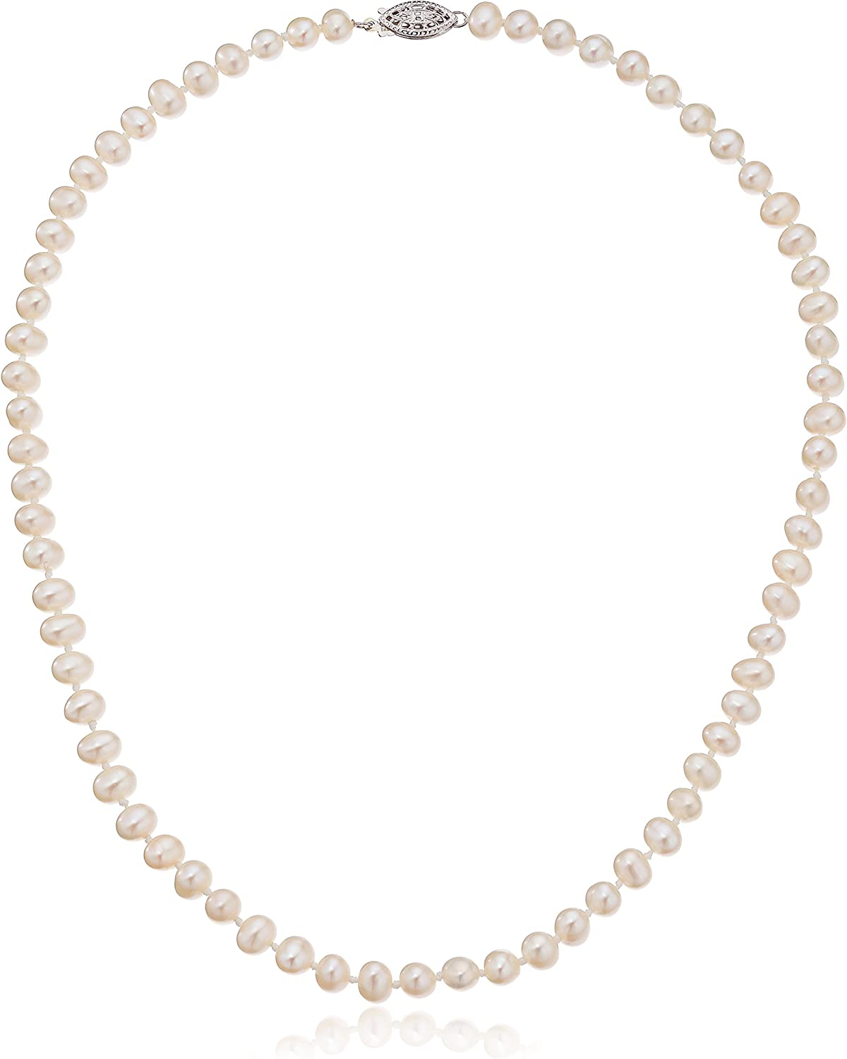
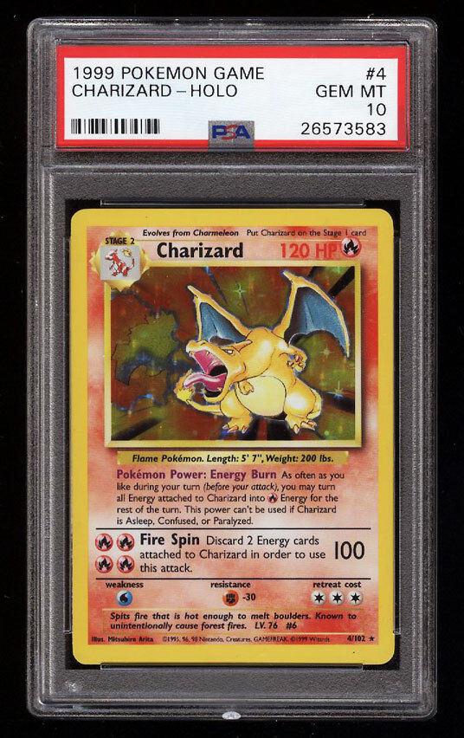

Knapsack Problem
You are a thief with a knapsack that can hold up to N weight. You are robbing a store, where each item has a weight, and a value
Goal: Maximize value of items being stolen, and don’t overfill knapsack
Knapsack (10)
Value: 10
Weight: 5
Value: 40
Weight: 4
Value: 30
Weight: 6
Value: 50
Weight: 3
Suppose our knapsack can only hold 10 pounds
Ideas?
10

Slide 11
Knapsack Problem
You are a thief with a knapsack that can hold up to N weight. You are robbing a store, where each item has a weight, and a value
Goal: Maximize value of items being stolen, and don’t overfill knapsack
Knapsack (0)
Value: 10
Weight: 5
Value: 40
Weight: 4
Value: 30
Weight: 6
Value: 50
Weight: 3
Suppose our knapsack can only hold 10 pounds
Stuff our knapsack with the most expensive items until we can’t fit anymore
11

Slide 12

Knapsack Problem
You are a thief with a knapsack that can hold up to N weight. You are robbing a store, where each item has a weight, and a value
Goal: Maximize value of items being stolen, and don’t overfill knapsack
Knapsack (7)
Value: 10
Weight: 5
Value: 40
Weight: 4
Value: 30
Weight: 6
Value: 50
Weight: 3
Suppose our knapsack can only hold 10 pounds
Stuff our knapsack with the most expensive items until we can’t fit anymore
Total value = $90
12

Slide 13
Knapsack Problem
You are a thief with a knapsack that can hold up to N weight. You are robbing a store, where each item has a weight, and a value
Goal: Maximize value of items being stolen, and don’t overfill knapsack
Knapsack (0)
Value: 10
Weight: 5
Value: 40
Weight: 4
Value: 30
Weight: 6
Value: 50
Weight: 10
Suppose our knapsack can only hold 10 pounds
Stuff our knapsack with the most expensive items until we can’t fit anymore
13

Slide 14

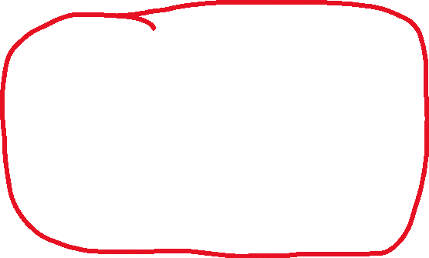

Knapsack Problem
You are a thief with a knapsack that can hold up to N weight. You are robbing a store, where each item has a weight, and a value
Goal: Maximize value of items being stolen, and don’t overfill knapsack
Knapsack (10)
Value: 10
Weight: 5
Value: 40
Weight: 4
Value: 30
Weight: 6
Value: 50
Weight: 10
Suppose our knapsack can only hold 10 pounds
Stuff our knapsack with the most expensive items until we can’t fit anymore
Taking these two items instead yields a more optimal solution!
Total value = $50
14

Slide 15
Knapsack Problem
You are a thief with a knapsack that can hold up to N weight. You are robbing a store, where each item has a weight, and a value
Goal: Maximize value of items being stolen, and don’t overfill knapsack
Knapsack (0)
Value: 10
Weight: 5
Value: 40
Weight: 4
Value: 30
Weight: 6
Value: 50
Weight: 10
Suppose our knapsack can only hold 10 pounds
Any better ideas?
15

Slide 16
Knapsack Problem
You are a thief with a knapsack that can hold up to N weight. You are robbing a store, where each item has a weight, and a value
Goal: Maximize value of items being stolen, and don’t overfill knapsack
Knapsack (0)
Value: 10
Weight: 5
Value: 40
Weight: 4
Value: 30
Weight: 6
Value: 50
Weight: 10
Suppose our knapsack can only hold 10 pounds
Compute the ratio of value/weight, and select items based on that
16

Slide 17
Knapsack Problem
You are a thief with a knapsack that can hold up to N weight. You are robbing a store, where each item has a weight, and a value
Goal: Maximize value of items being stolen, and don’t overfill knapsack
Knapsack (0)
Value: 10
Weight: 5
Ratio: 2
Value: 40
Weight: 4
Ratio: 10
Value: 30
Weight: 6
Ratio: 5
Value: 50
Weight: 10
Ratio: 5
Compute the ratio of value/weight, and select items based on that
17

Slide 18
Knapsack Problem
You are a thief with a knapsack that can hold up to N weight. You are robbing a store, where each item has a weight, and a value
Goal: Maximize value of items being stolen, and don’t overfill knapsack
Knapsack (0)
1. Sort items based on ratio
Value: 40
Weight: 4
Ratio: 10
Value: 30
Weight: 6
Ratio: 5
Value: 10
Weight: 5
Ratio: 2
Value: 50
Weight: 10
Ratio: 5
Compute the ratio of value/weight, and select items based on that
18

Slide 19
Knapsack Problem
You are a thief with a knapsack that can hold up to N weight. You are robbing a store, where each item has a weight, and a value
Goal: Maximize value of items being stolen, and don’t overfill knapsack
Knapsack (0)
Sort items based on ratio
Add items to knapsack if they will not exceed the knapsack
Repeat step 2 until we’ve checked every item
Value: 40
Weight: 4
Ratio: 10
Value: 30
Weight: 6
Ratio: 5
Value: 10
Weight: 5
Ratio: 2
Value: 50
Weight: 10
Ratio: 5
Compute the ratio of value/weight, and select items based on that
19

Slide 20
Knapsack Problem
You are a thief with a knapsack that can hold up to N weight. You are robbing a store, where each item has a weight, and a value
Goal: Maximize value of items being stolen, and don’t overfill knapsack
Knapsack (4)
Sort items based on ratio
Add items to knapsack if they will not exceed the knapsack
Repeat step 2 until we’ve checked every item
Value: 40
Weight: 4
Ratio: 10
Value: 30
Weight: 6
Ratio: 5
Value: 10
Weight: 5
Ratio: 2
Value: 50
Weight: 10
Ratio: 5
Compute the ratio of value/weight, and select items based on that
20

Slide 21
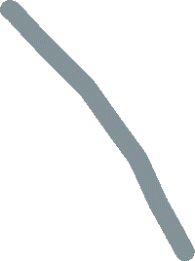


Knapsack Problem
You are a thief with a knapsack that can hold up to N weight. You are robbing a store, where each item has a weight, and a value
Goal: Maximize value of items being stolen, and don’t overfill knapsack
Knapsack (4)
Sort items based on ratio
Add items to knapsack if they will not exceed the knapsack
Repeat step 2 until we’ve checked every item
Value: 40
Weight: 4
Ratio: 10
Value: 30
Weight: 6
Ratio: 5
Value: 10
Weight: 5
Ratio: 2
Value: 50
Weight: 10
Ratio: 5
Compute the ratio of value/weight, and select items based on that
We cannot select this item, because it will exceed the knapsack
21

Slide 22




Knapsack Problem
You are a thief with a knapsack that can hold up to N weight. You are robbing a store, where each item has a weight, and a value
Goal: Maximize value of items being stolen, and don’t overfill knapsack
Knapsack (4)
Sort items based on ratio
Add items to knapsack if they will not exceed the knapsack
Repeat step 2 until we’ve checked every item
Value: 40
Weight: 4
Ratio: 10
Value: 30
Weight: 6
Ratio: 5
Value: 10
Weight: 5
Ratio: 2
Value: 50
Weight: 10
Ratio: 5
Compute the ratio of value/weight, and select items based on that
22

Slide 23


Knapsack Problem
You are a thief with a knapsack that can hold up to N weight. You are robbing a store, where each item has a weight, and a value
Goal: Maximize value of items being stolen, and don’t overfill knapsack
Knapsack (10)
Sort items based on ratio
Add items to knapsack if they will not exceed the knapsack
Repeat step 2 until we’ve checked every item
Value: 40
Weight: 4
Ratio: 10
Value: 30
Weight: 6
Ratio: 5
Value: 10
Weight: 5
Ratio: 2
Value: 50
Weight: 10
Ratio: 5
Compute the ratio of value/weight, and select items based on that
23

Slide 24
Knapsack Problem
You are a thief with a knapsack that can hold up to N weight. You are robbing a store, where each item has a weight, and a value
Goal: Maximize value of items being stolen, and don’t overfill knapsack
Knapsack (10)
Sort items based on ratio
Add items to knapsack if they will not exceed the knapsack
Repeat step 2 until we’ve checked every item
Value: 40
Weight: 4
Ratio: 10
Value: 30
Weight: 6
Ratio: 5
Value: 10
Weight: 5
Ratio: 2
Value: 50
Weight: 10
Ratio: 5
Compute the ratio of value/weight, and select items based on that
We cannot select this item, because it will exceed the knapsack
24

Slide 25
Knapsack Problem
You are a thief with a knapsack that can hold up to N weight. You are robbing a store, where each item has a weight, and a value
Goal: Maximize value of items being stolen, and don’t overfill knapsack
Knapsack (10)
Sort items based on ratio
Add items to knapsack if they will not exceed the knapsack
Repeat step 2 until we’ve checked every item
Value: 40
Weight: 4
Ratio: 10
Value: 30
Weight: 6
Ratio: 5
Value: 10
Weight: 5
Ratio: 2
Value: 50
Weight: 10
Ratio: 5
Compute the ratio of value/weight, and select items based on that
Total profit of knapsack: $40 + $30 = $70
25

Slide 26
Knapsack Problem
You are a thief with a knapsack that can hold up to N weight. You are robbing a store, where each item has a weight, and a value
Goal: Maximize value of items being stolen, and don’t overfill knapsack
Knapsack (0)
Sort items based on ratio
Add items to knapsack if they will not exceed the knapsack
Repeat step 2 until we’ve checked every item
Value: 5.5
Weight: 4
Ratio: 1.38
Value: 4
Weight: 3
Ratio: 1.33
Value: 4
Weight: 3
Ratio: 1.33
Let N = 6
Given these new prices, weights, and ratios, will our algorithm still work?
Compute the ratio of value/weight, and select items based on that
26

Slide 27
Knapsack Problem
You are a thief with a knapsack that can hold up to N weight. You are robbing a store, where each item has a weight, and a value
Goal: Maximize value of items being stolen, and don’t overfill knapsack
Knapsack (4)
We can’t add these items, because they would exceed our knapsack capacity
Sort items based on ratio
Add items to knapsack if they will not exceed the knapsack
Repeat step 2 until we’ve checked every item
Value: 5.5
Weight: 4
Ratio: 1.38
Value: 4
Weight: 3
Ratio: 1.33
Value: 4
Weight: 3
Ratio: 1.33
Let N = 6
Given these new prices, weights, and ratios, will our algorithm still work?
Compute the ratio of value/weight, and select items based on that
Total profit = 5.5
27

Slide 28
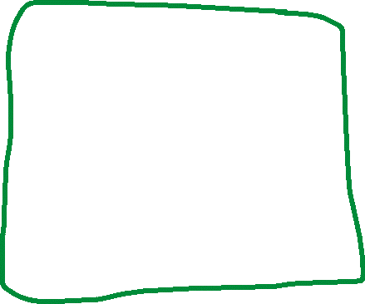
Knapsack Problem
You are a thief with a knapsack that can hold up to N weight. You are robbing a store, where each item has a weight, and a value
Goal: Maximize value of items being stolen, and don’t overfill knapsack
Knapsack (4)
Sort items based on ratio
Add items to knapsack if they will not exceed the knapsack
Repeat step 2 until we’ve checked every item
Value: 5.5
Weight: 4
Ratio: 1.38
Value: 4
Weight: 3
Ratio: 1.33
Value: 4
Weight: 3
Ratio: 1.33
Let N = 6
Given these new prices, weights, and ratios, will our algorithm still work?
Compute the ratio of value/weight, and select items based on that
Total profit = 5.5
Optimal solution= 8
28

Slide 29
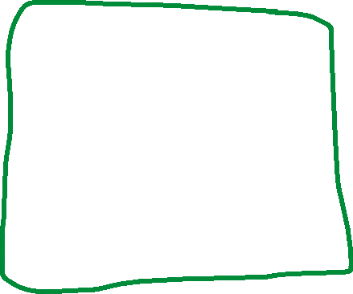
Knapsack Problem
This is the 0/1 knapsack problem, which means that we either take the item, or we don’t. We can’t take “half” of a watch to fill the remaining empty space of our knapsack
The greedy approach does not always yield the optimal solution ☹
You are a thief with a knapsack that can hold up to N weight. You are robbing a store, where each item has a weight, and a value
Goal: Maximize value of items being stolen, and don’t overfill knapsack
Knapsack (4)
Sort items based on ratio
Add items to knapsack if they will not exceed the knapsack
Repeat step 2 until we’ve checked every item
Value: 5.5
Weight: 4
Ratio: 1.38
Value: 4
Weight: 3
Ratio: 1.33
Value: 4
Weight: 3
Ratio: 1.33
Let N = 6
Given these new prices, weights, and ratios, will our algorithm still work?
Compute the ratio of value/weight, and select items based on that
Total profit = 5.5
Optimal solution= 8
29

Slide 30
Knapsack Problem (Fractional)
You are a thief with a knapsack that can hold up to N weight. You are robbing a store, where each item has a weight, and a value
Goal: Maximize value of items being stolen, and don’t overfill knapsack
Knapsack (n)
Fractional variant = we can take a fraction of an item
30

Slide 31


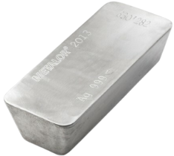
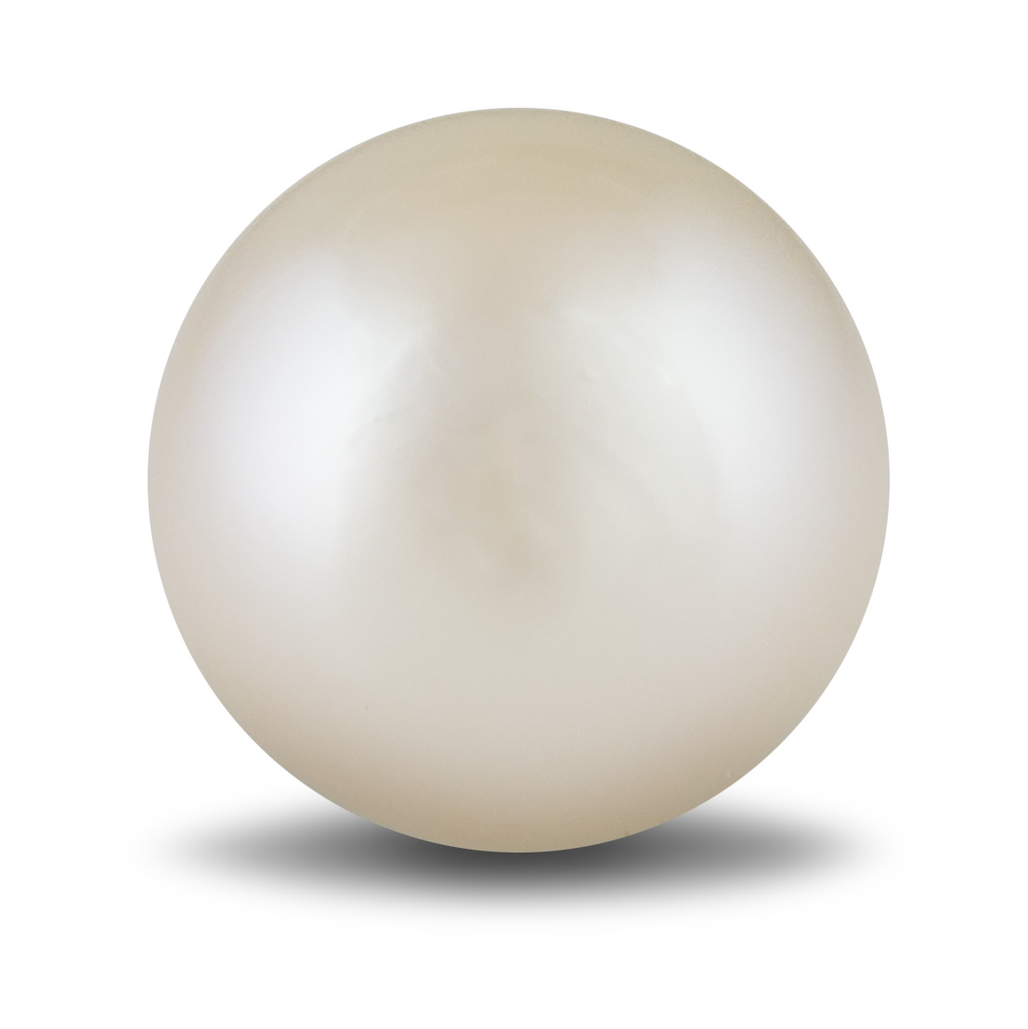
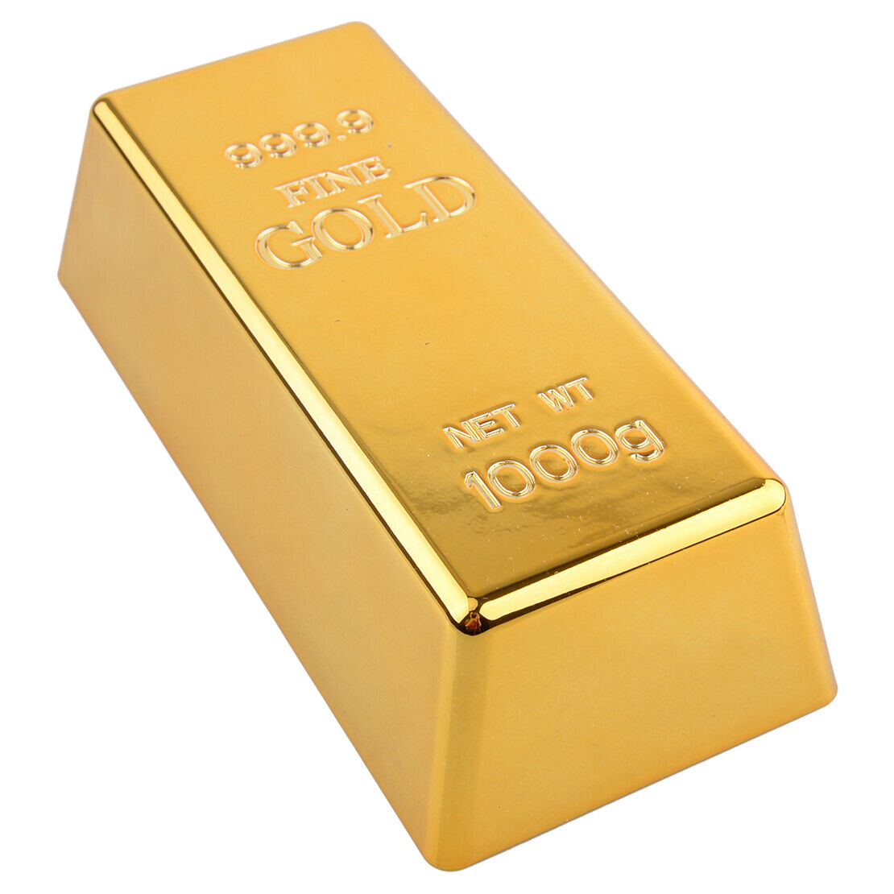

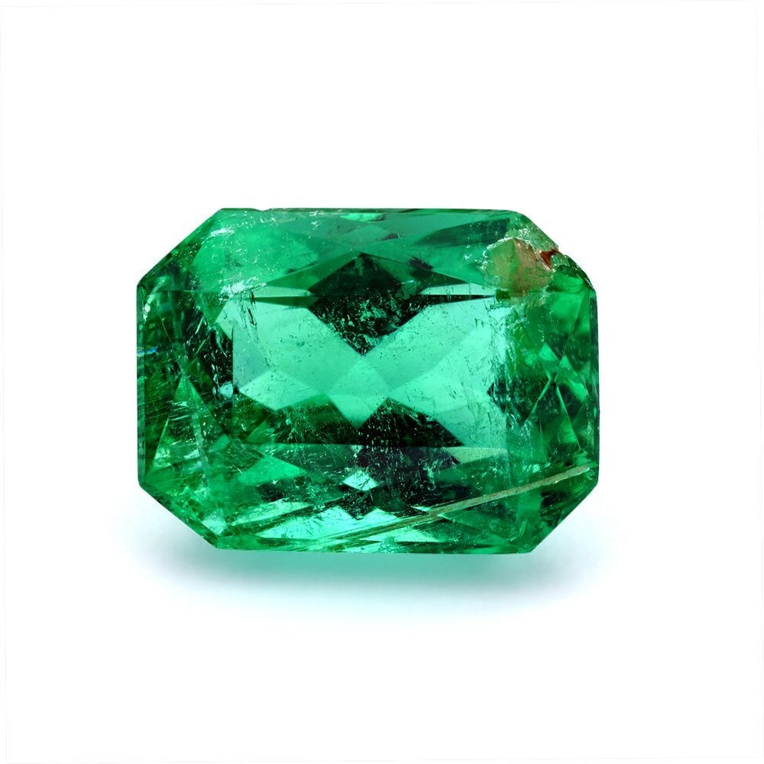
Knapsack Problem (Fractional)
Value: 40
Weight: 5
Value: 100
Weight: 20
Value: 13
Weight: 10
Value: 52
Weight: 8
Value: 88
Weight: 12
Value: 13
Weight: 8
Value: 20
Weight: 1
Knapsack (n)
Knapsack capacity: 35
31

Slide 32
Knapsack Problem (Fractional)
Value: 40
Weight: 5
Ratio: 8
Value: 100
Weight: 20
Ratio: 5
Value: 13
Weight: 10:
Ratio 1.3
Value: 52
Weight: 8
Ratio: 6.5
Value: 88
Weight: 12
Ratio: 7.33
Value: 13
Weight: 8
Ratio: 1.625
Value: 20
Weight: 1
Ratio: 20
Knapsack (n)
Knapsack capacity: 35
Sort items based on ratio
32

Slide 33
Knapsack Problem (Fractional)
Value: 20
Weight: 1
Ratio: 20
Value: 40
Weight: 5
Ratio: 8
Value: 88
Weight: 12
Ratio: 7.33
Value: 52
Weight: 8
Ratio: 6.5
Value: 100
Weight: 20
Ratio: 5
Value: 13
Weight: 8
Ratio: 1.625
Value: 13
Weight: 10:
Ratio 1.3
Knapsack (n)
Knapsack capacity: 35
Sort items based on ratio
33

Slide 34
Knapsack Problem (Fractional)
Value: 20
Weight: 1
Ratio: 20
Value: 40
Weight: 5
Ratio: 8
Value: 88
Weight: 12
Ratio: 7.33
Value: 52
Weight: 8
Ratio: 6.5
Value: 100
Weight: 20
Ratio: 5
Value: 13
Weight: 8
Ratio: 1.625
Value: 13
Weight: 10:
Ratio 1.3
Knapsack (n)
Knapsack capacity: 35
Sort items based on ratio
Iterate through sorted list
If adding item will not exceed the capacity, add it
If adding item will exceed the capacity, take a fraction of it to fill the remaining space of knapsack
34

Slide 35
Knapsack Problem (Fractional)
Value: 20
Weight: 1
Ratio: 20
Value: 40
Weight: 5
Ratio: 8
Value: 88
Weight: 12
Ratio: 7.33
Value: 52
Weight: 8
Ratio: 6.5
Value: 100
Weight: 20
Ratio: 5
Value: 13
Weight: 8
Ratio: 1.625
Value: 13
Weight: 10:
Ratio 1.3
Knapsack capacity: 35
Sort items based on ratio
Iterate through sorted list
If adding item will not exceed the capacity, add it
If adding item will exceed the capacity, take a fraction of it to fill the remaining space of knapsack
Knapsack (0)
35

Slide 36
Knapsack Problem (Fractional)
Value: 20
Weight: 1
Ratio: 20
Value: 40
Weight: 5
Ratio: 8
Value: 88
Weight: 12
Ratio: 7.33
Value: 52
Weight: 8
Ratio: 6.5
Value: 100
Weight: 20
Ratio: 5
Value: 13
Weight: 8
Ratio: 1.625
Value: 13
Weight: 10:
Ratio 1.3
Knapsack capacity: 35
Sort items based on ratio
Iterate through sorted list
If adding item will not exceed the capacity, add it
If adding item will exceed the capacity, take a fraction of it to fill the remaining space of knapsack
Knapsack (1)
36

Slide 37
Knapsack Problem (Fractional)
Value: 20
Weight: 1
Ratio: 20
Value: 40
Weight: 5
Ratio: 8
Value: 88
Weight: 12
Ratio: 7.33
Value: 52
Weight: 8
Ratio: 6.5
Value: 100
Weight: 20
Ratio: 5
Value: 13
Weight: 8
Ratio: 1.625
Value: 13
Weight: 10:
Ratio 1.3
Knapsack capacity: 35
Sort items based on ratio
Iterate through sorted list
If adding item will not exceed the capacity, add it
If adding item will exceed the capacity, take a fraction of it to fill the remaining space of knapsack
Knapsack (1)
37

Slide 38
Knapsack Problem (Fractional)
Value: 20
Weight: 1
Ratio: 20
Value: 40
Weight: 5
Ratio: 8
Value: 88
Weight: 12
Ratio: 7.33
Value: 52
Weight: 8
Ratio: 6.5
Value: 100
Weight: 20
Ratio: 5
Value: 13
Weight: 8
Ratio: 1.625
Value: 13
Weight: 10:
Ratio 1.3
Knapsack capacity: 35
Sort items based on ratio
Iterate through sorted list
If adding item will not exceed the capacity, add it
If adding item will exceed the capacity, take a fraction of it to fill the remaining space of knapsack
Knapsack (6)
38

Slide 39
Knapsack Problem (Fractional)
Value: 20
Weight: 1
Ratio: 20
Value: 40
Weight: 5
Ratio: 8
Value: 88
Weight: 12
Ratio: 7.33
Value: 52
Weight: 8
Ratio: 6.5
Value: 100
Weight: 20
Ratio: 5
Value: 13
Weight: 8
Ratio: 1.625
Value: 13
Weight: 10:
Ratio 1.3
Knapsack capacity: 35
Sort items based on ratio
Iterate through sorted list
If adding item will not exceed the capacity, add it
If adding item will exceed the capacity, take a fraction of it to fill the remaining space of knapsack
Knapsack (6)
39

Slide 40
Knapsack Problem (Fractional)
Value: 20
Weight: 1
Ratio: 20
Value: 40
Weight: 5
Ratio: 8
Value: 88
Weight: 12
Ratio: 7.33
Value: 52
Weight: 8
Ratio: 6.5
Value: 100
Weight: 20
Ratio: 5
Value: 13
Weight: 8
Ratio: 1.625
Value: 13
Weight: 10:
Ratio 1.3
Knapsack capacity: 35
Sort items based on ratio
Iterate through sorted list
If adding item will not exceed the capacity, add it
If adding item will exceed the capacity, take a fraction of it to fill the remaining space of knapsack
Knapsack (18)
40

Slide 41
Knapsack Problem (Fractional)
Value: 20
Weight: 1
Ratio: 20
Value: 40
Weight: 5
Ratio: 8
Value: 88
Weight: 12
Ratio: 7.33
Value: 52
Weight: 8
Ratio: 6.5
Value: 100
Weight: 20
Ratio: 5
Value: 13
Weight: 8
Ratio: 1.625
Value: 13
Weight: 10:
Ratio 1.3
Knapsack capacity: 35
Sort items based on ratio
Iterate through sorted list
If adding item will not exceed the capacity, add it
If adding item will exceed the capacity, take a fraction of it to fill the remaining space of knapsack
Knapsack (18)
41

Slide 42
Knapsack Problem (Fractional)
Value: 20
Weight: 1
Ratio: 20
Value: 40
Weight: 5
Ratio: 8
Value: 88
Weight: 12
Ratio: 7.33
Value: 52
Weight: 8
Ratio: 6.5
Value: 100
Weight: 20
Ratio: 5
Value: 13
Weight: 8
Ratio: 1.625
Value: 13
Weight: 10:
Ratio 1.3
Knapsack capacity: 35
Sort items based on ratio
Iterate through sorted list
If adding item will not exceed the capacity, add it
If adding item will exceed the capacity, take a fraction of it to fill the remaining space of knapsack
Knapsack (26)
42

Slide 43
Knapsack Problem (Fractional)
Value: 20
Weight: 1
Ratio: 20
Value: 40
Weight: 5
Ratio: 8
Value: 88
Weight: 12
Ratio: 7.33
Value: 52
Weight: 8
Ratio: 6.5
Value: 100
Weight: 20
Ratio: 5
Value: 13
Weight: 8
Ratio: 1.625
Value: 13
Weight: 10:
Ratio 1.3
Knapsack capacity: 35
Sort items based on ratio
Iterate through sorted list
If adding item will not exceed the capacity, add it
If adding item will exceed the capacity, take a fraction of it to fill the remaining space of knapsack
Knapsack (26)
43

Slide 44
Knapsack Problem (Fractional)
Value: 20
Weight: 1
Ratio: 20
Value: 40
Weight: 5
Ratio: 8
Value: 88
Weight: 12
Ratio: 7.33
Value: 52
Weight: 8
Ratio: 6.5
Value: 100
Weight: 20
Ratio: 5
Value: 13
Weight: 8
Ratio: 1.625
Value: 13
Weight: 10:
Ratio 1.3
Knapsack capacity: 35
Sort items based on ratio
Iterate through sorted list
If adding item will not exceed the capacity, add it
If adding item will exceed the capacity, take a fraction of it to fill the remaining space of knapsack
Knapsack (26)
We cannot take the full 20 pounds of the gold bar, but we can take a fraction of it
Cut off 9 pounds of the gold bar, and place it in out knapsack
44

Slide 45
Knapsack Problem (Fractional)
Value: 20
Weight: 1
Ratio: 20
Value: 40
Weight: 5
Ratio: 8
Value: 88
Weight: 12
Ratio: 7.33
Value: 52
Weight: 8
Ratio: 6.5
Value: 100
Weight: 20
Ratio: 5
Value: 13
Weight: 8
Ratio: 1.625
Value: 13
Weight: 10:
Ratio 1.3
Knapsack capacity: 35
Sort items based on ratio
Iterate through sorted list
If adding item will not exceed the capacity, add it
If adding item will exceed the capacity, take a fraction of it to fill the remaining space of knapsack
Knapsack (35)
45

Slide 46
Knapsack Problem (Fractional)
Value: 20
Weight: 1
Ratio: 20
Value: 40
Weight: 5
Ratio: 8
Value: 88
Weight: 12
Ratio: 7.33
Value: 52
Weight: 8
Ratio: 6.5
Value: 100
Weight: 20
Ratio: 5
Value: 13
Weight: 8
Ratio: 1.625
Value: 13
Weight: 10:
Ratio 1.3
Knapsack capacity: 35
Pearl: 20
Emerald: 40
Silver: 88
Sapphire: 52
9/20 of a gold bar: ???
Sort items based on ratio
Iterate through sorted list
If adding item will not exceed the capacity, add it
If adding item will exceed the capacity, take a fraction of it to fill the remaining space of knapsack
Knapsack (35)
46

Slide 47
Knapsack Problem (Fractional)
Value: 20
Weight: 1
Ratio: 20
Value: 40
Weight: 5
Ratio: 8
Value: 88
Weight: 12
Ratio: 7.33
Value: 52
Weight: 8
Ratio: 6.5
Value: 100
Weight: 20
Ratio: 5
Value: 13
Weight: 8
Ratio: 1.625
Value: 13
Weight: 10:
Ratio 1.3
Knapsack capacity: 35
Pearl: 20
Emerald: 40
Silver: 88
Sapphire: 52
9/20 of a gold bar: 9 * 5 = 45
Sort items based on ratio
Iterate through sorted list
If adding item will not exceed the capacity, add it
If adding item will exceed the capacity, take a fraction of it to fill the remaining space of knapsack
Knapsack (35)
the ratio
47

Slide 48
Knapsack Problem (Fractional)
Value: 20
Weight: 1
Ratio: 20
Value: 40
Weight: 5
Ratio: 8
Value: 88
Weight: 12
Ratio: 7.33
Value: 52
Weight: 8
Ratio: 6.5
Value: 100
Weight: 20
Ratio: 5
Value: 13
Weight: 8
Ratio: 1.625
Value: 13
Weight: 10:
Ratio 1.3
Knapsack capacity: 35
Pearl: 20
Emerald: 40
Silver: 88
Sapphire: 52
9/20 of a gold bar: 9 * 5 = 45
Sort items based on ratio
Iterate through sorted list
If adding item will not exceed the capacity, add it
If adding item will exceed the capacity, take a fraction of it to fill the remaining space of knapsack
Knapsack (35)
the ratio
Total profit: $245
48

Slide 49
Knapsack Problem (Fractional)
In the fractional knapsack problem, the greedy approach will guarantee an optimal solution
Value: 20
Weight: 1
Ratio: 20
Value: 40
Weight: 5
Ratio: 8
Value: 88
Weight: 12
Ratio: 7.33
Value: 52
Weight: 8
Ratio: 6.5
Value: 100
Weight: 20
Ratio: 5
Value: 13
Weight: 8
Ratio: 1.625
Value: 13
Weight: 10:
Ratio 1.3
Knapsack capacity: 35
Pearl: 20
Emerald: 40
Silver: 88
Sapphire: 52
9/20 of a gold bar: 9 * 5 = 45
Sort items based on ratio
Iterate through sorted list
If adding item will not exceed the capacity, add it
If adding item will exceed the capacity, take a fraction of it to fill the remaining space of knapsack
Knapsack (35)
the ratio
Total profit: $245
49

Slide 50


Being a Cashier at Walmart
Customer are constantly arriving to a check out line. Walmart is open 24/7
Instead of first-in-first-out, you want to serve as many customers as possible in your 2-hour shift
You can assume that there will always be several waiting in line, and you know how many minutes it will take to check them out
50

Slide 51
Being a Cashier at Walmart
Customer are constantly arriving to a check out line. Walmart is open 24/7
Instead of first-in-first-out, you want to serve as many customers as possible in your 2-hour shift
You can assume that there will always be several waiting in line, and you know how many minutes it will take to check them out
51

Slide 52
Being a Cashier at Walmart
Customer are constantly arriving to a check out line. Walmart is open 24/7
Instead of first-in-first-out, you want to serve as many customers as possible in your 2-hour shift
You can assume that there will always be several waiting in line, and you know how many minutes it will take to check them out
52

Slide 53
Being a Cashier at Walmart
Customer are constantly arriving to a check out line. Walmart is open 24/7
Instead of first-in-first-out, you want to serve as many customers as possible in your 2-hour shift
You can assume that there will always be several waiting in line, and you know how many minutes it will take to check them out
3 min
7 min
15 min
1 min
5 min
53

Slide 54
Being a Cashier at Walmart
Customer are constantly arriving to a check out line. Walmart is open 24/7
Instead of first-in-first-out, you want to serve as many customers as possible in your 2-hour shift
You can assume that there will always be several waiting in line, and you know how many minutes it will take to check them out
3 min
7 min
15 min
1 min
5 min
Any ideas to achieve our goal?
54

Slide 55
Being a Cashier at Walmart
Customer are constantly arriving to a check out line. Walmart is open 24/7
Instead of first-in-first-out, you want to serve as many customers as possible in your 2-hour shift
You can assume that there will always be several waiting in line, and you know how many minutes it will take to check them out
3 min
7 min
15 min
1 min
5 min
Select the customer that would take the least time
55

Slide 56
Being a Cashier at Walmart
Customer are constantly arriving to a check out line. Walmart is open 24/7
Instead of first-in-first-out, you want to serve as many customers as possible in your 2-hour shift
You can assume that there will always be several waiting in line, and you know how many minutes it will take to check them out
1 min
3 min
7 min
15 min
5 min
Select the customer that would take the least time
56

Slide 57
Being a Cashier at Walmart
Customer are constantly arriving to a check out line. Walmart is open 24/7
Instead of first-in-first-out, you want to serve as many customers as possible in your 2-hour shift
You can assume that there will always be several waiting in line, and you know how many minutes it will take to check them out
3 min
7 min
15 min
5 min
Select the customer that would take the least time
57

Slide 58
Being a Cashier at Walmart
Customer are constantly arriving to a check out line. Walmart is open 24/7
Instead of first-in-first-out, you want to serve as many customers as possible in your 2-hour shift
You can assume that there will always be several waiting in line, and you know how many minutes it will take to check them out
3 min
7 min
15 min
5 min
Select the customer that would take the least time
58

Slide 59
Being a Cashier at Walmart
Customer are constantly arriving to a check out line. Walmart is open 24/7
Instead of first-in-first-out, you want to serve as many customers as possible in your 2-hour shift
You can assume that there will always be several waiting in line, and you know how many minutes it will take to check them out
3 min
2 min
7 min
15 min
5 min
Select the customer that would take the least time
59

Slide 60
Being a Cashier at Walmart
Customer are constantly arriving to a check out line. Walmart is open 24/7
Instead of first-in-first-out, you want to serve as many customers as possible in your 2-hour shift
You can assume that there will always be several waiting in line, and you know how many minutes it will take to check them out
2 min
7 min
15 min
5 min
Select the customer that would take the least time
60

Slide 61
Being a Cashier at Walmart
Customer are constantly arriving to a check out line. Walmart is open 24/7
Instead of first-in-first-out, you want to serve as many customers as possible in your 2-hour shift
You can assume that there will always be several waiting in line, and you know how many minutes it will take to check them out
2 min
7 min
15 min
5 min
Select the customer that would take the least time
61

Slide 62
Being a Cashier at Walmart
Customer are constantly arriving to a check out line. Walmart is open 24/7
Instead of first-in-first-out, you want to serve as many customers as possible in your 2-hour shift
You can assume that there will always be several waiting in line, and you know how many minutes it will take to check them out
2 min
6 min
7 min
15 min
8 min
5 min
Select the customer that would take the least time
62

Slide 63
Being a Cashier at Walmart
Customer are constantly arriving to a check out line. Walmart is open 24/7
Instead of first-in-first-out, you want to serve as many customers as possible in your 2-hour shift
You can assume that there will always be several waiting in line, and you know how many minutes it will take to check them out
5 min
6 min
7 min
15 min
8 min
Select the customer that would take the least time
63

Slide 64
Being a Cashier at Walmart
Customer are constantly arriving to a check out line. Walmart is open 24/7
Instead of first-in-first-out, you want to serve as many customers as possible in your 2-hour shift
You can assume that there will always be several waiting in line, and you know how many minutes it will take to check them out
6 min
7 min
15 min
8 min
Select the customer that would take the least time
64

Slide 65
Being a Cashier at Walmart
Customer are constantly arriving to a check out line. Walmart is open 24/7
Instead of first-in-first-out, you want to serve as many customers as possible in your 2-hour shift
You can assume that there will always be several waiting in line, and you know how many minutes it will take to check them out
6 min
7 min
15 min
8 min
Select the customer that would take the least time
65

Slide 66
Being a Cashier at Walmart
Customer are constantly arriving to a check out line. Walmart is open 24/7
Instead of first-in-first-out, you want to serve as many customers as possible in your 2-hour shift
You can assume that there will always be several waiting in line, and you know how many minutes it will take to check them out
7 min
15 min
8 min
Select the customer that would take the least time
66

Slide 67
Being a Cashier at Walmart
Customer are constantly arriving to a check out line. Walmart is open 24/7
Instead of first-in-first-out, you want to serve as many customers as possible in your 2-hour shift
You can assume that there will always be several waiting in line, and you know how many minutes it will take to check them out
7 min
15 min
8 min
Select the customer that would take the least time
67

Slide 68
Being a Cashier at Walmart
Customer are constantly arriving to a check out line. Walmart is open 24/7
Instead of first-in-first-out, you want to serve as many customers as possible in your 2-hour shift
You can assume that there will always be several waiting in line, and you know how many minutes it will take to check them out
7 min
11 min
15 min
8 min
Select the customer that would take the least time
And repeat this until your shift is over!
68

Slide 69
Being a Cashier at Walmart
Customer are constantly arriving to a check out line. Walmart is open 24/7
Instead of first-in-first-out, you want to serve as many customers as possible in your 2-hour shift
You can assume that there will always be several waiting in line, and you know how many minutes it will take to check them out
7 min
Select the customer that would take the least time
11 min
15 min
8 min
Is this algorithm good?
69

Slide 70
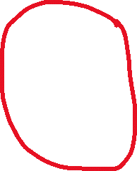
Being a Cashier at Walmart
Customer are constantly arriving to a check out line. Walmart is open 24/7
Instead of first-in-first-out, you want to serve as many customers as possible in your 2-hour shift
You can assume that there will always be several waiting in line, and you know how many minutes it will take to check them out
7 min
Select the customer that would take the least time
11 min
15 min
8 min
Optimal, but not Fair!
This customer has a longer service time, and they may potentially wait a very long time until they are served
70

Slide 71



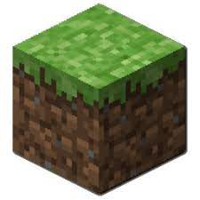

Being a Cashier at Walmart CPU Job Scheduling
This problem is very relevant in the world of operating systems.
There are many processes/software running on your computer all at the same time
Each process needs to use the hardware on the computer to do its job.
OS oversees selecting which job will be processed by the CPU next
Ideally, we want a fair approach ☺
Process A
Process B
Process C
Process D
11 nanoseconds
15 nanoseconds
8 nanoseconds
7 nanoseconds
71

Slide 72
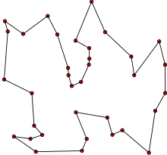
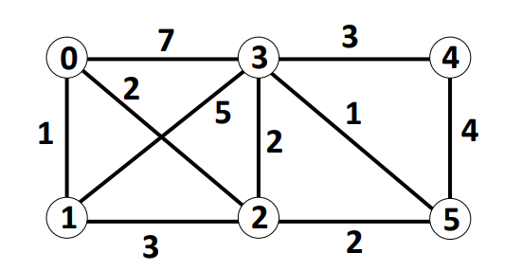



Traveling Salesman
Given a graph with edge weights and a starting node, what is the shortest path that will visit every node, and start and end at the starting node, without visiting the same node twice
Hamiltonian cycle
Shortest possible loop that connects every red dot, and does revisit any dot
72

Slide 73
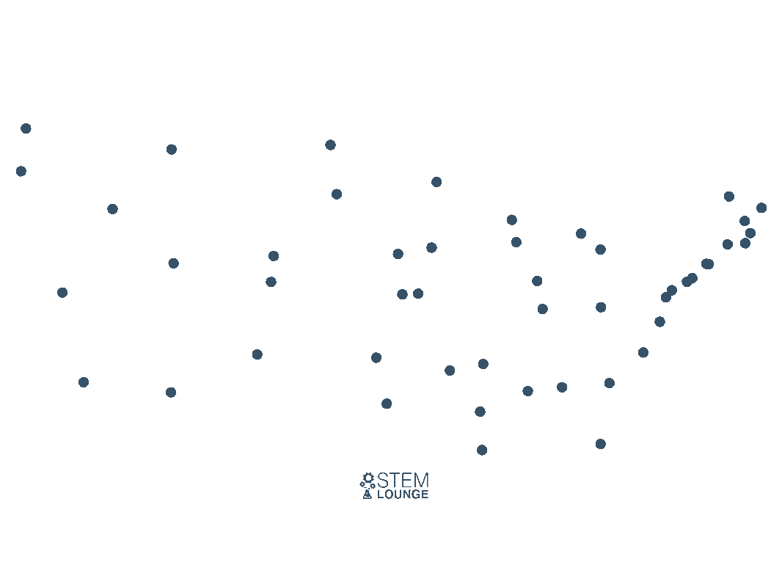
Traveling Salesman
Given a graph with edge weights and a starting node, what is the shortest path that will visit every node, and start and end at the starting node, without visiting the same node twice
Given the nodes of major cities in the US, what would the greedy algorithm look like for the TSP problem?
You can assume every node as a direct path to every other node
73

Slide 74
Traveling Salesman
Given a graph with edge weights and a starting node, what is the shortest path that will visit every node, and start and end at the starting node, without visiting the same node twice
Given the nodes of major cities in the US, what would the greedy algorithm look like for the TSP problem?
Nearest neighbor: always travel to the nearest unvisited neighbor, and then travel to their nearest neighbor, and then travel to their nearest neighbor…
Once we have visited all nodes, travel back to starting node
74

Slide 75
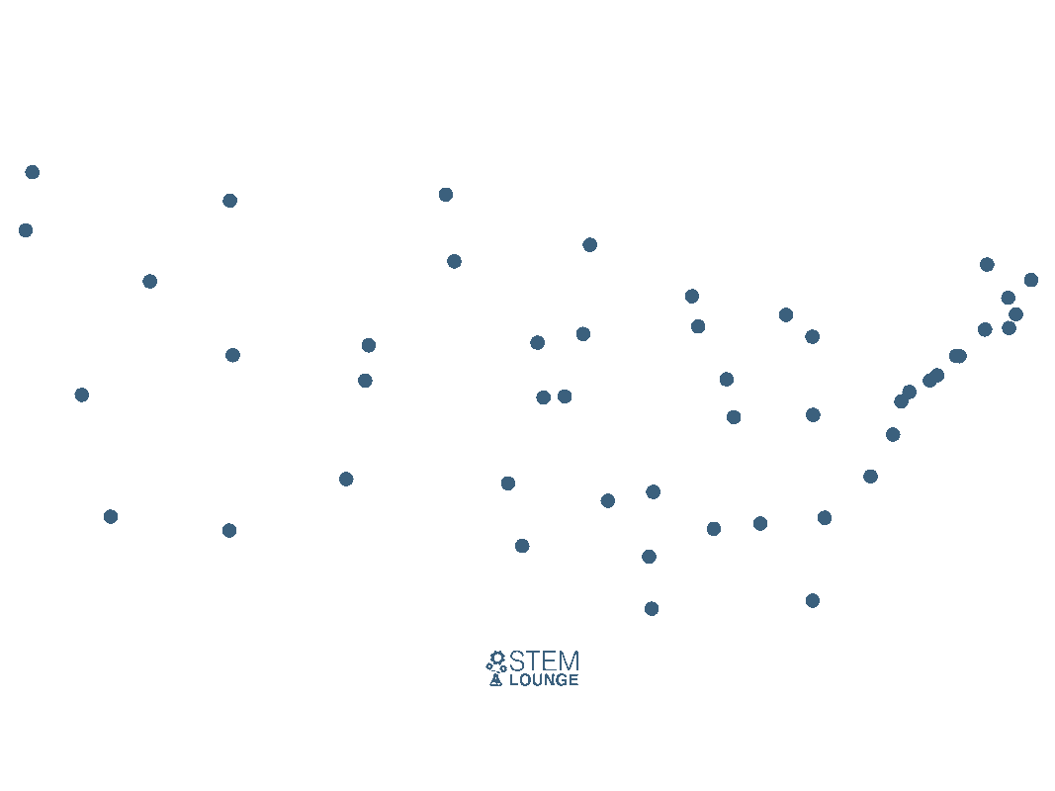
Traveling Salesman
Given a graph with edge weights and a starting node, what is the shortest path that will visit every node, and start and end at the starting node, without visiting the same node twice
Given the nodes of major cities in the US, what would the greedy algorithm look like for the TSP problem?
Nearest neighbor: always travel to the nearest unvisited neighbor, and then travel to their nearest neighbor, and then travel to their nearest neighbor…
Once we have visited all nodes, travel back to starting node
75

Slide 76
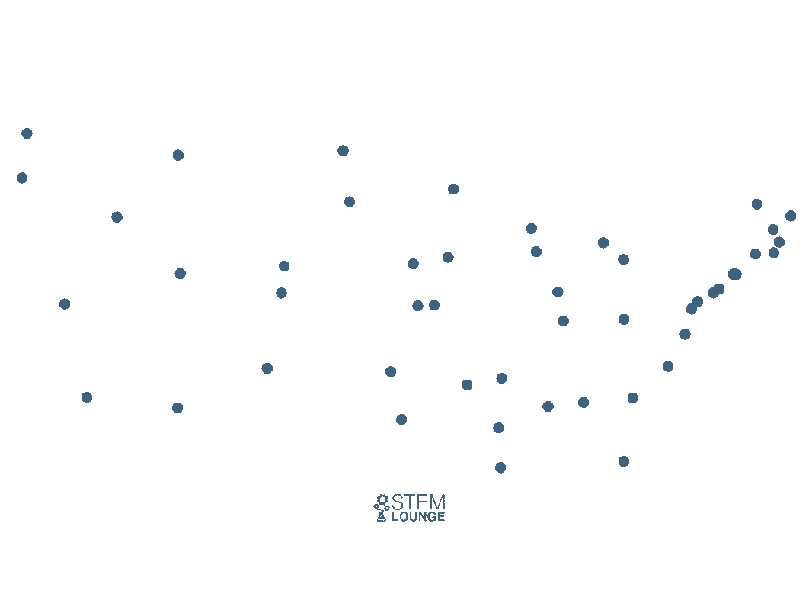
Traveling Salesman
Given a graph with edge weights and a starting node, what is the shortest path that will visit every node, and start and end at the starting node, without visiting the same node twice
Given the nodes of major cities in the US, what would the greedy algorithm look like for the TSP problem?
Lowest edge cost: add the shortest edge that will neither create a vertex with more than 2 edges, nor a cycle with less than the total number of cities until we have a cycle
76

Slide 77

Traveling Salesman
Given a graph with edge weights and a starting node, what is the shortest path that will visit every node, and start and end at the starting node, without visiting the same node twice
Given the nodes of major cities in the US, what would the greedy algorithm look like for the TSP problem?
Nearest Insertion
Start with a cycle, keep growing the cycle by adding the city nearest to the cycle
77

Slide 78
Traveling Salesman
Given a graph with edge weights and a starting node, what is the shortest path that will visit every node, and start and end at the starting node, without visiting the same node twice
Unfortunately, the greedy algorithms for TSP do not guarantee an optimal solution
78

Slide 79

Traveling Salesman
Given a graph with edge weights and a starting node, what is the shortest path that will visit every node, and start and end at the starting node, without visiting the same node twice
Unfortunately, the greedy algorithms for TSP do not guarantee an optimal solution
The traveling salesman problem is a difficult problem… in fact, it is one of the most difficult problems in computer science
We do not know of an algorithm that can solve TSP in polynomial time
O(1)
O(logn)
O(N^3)
O(n)
O(N^2)
O(n log n)
Polynomial time
79

Slide 80

Traveling Salesman
Given a graph with edge weights and a starting node, what is the shortest path that will visit every node, and start and end at the starting node, without visiting the same node twice
Unfortunately, the greedy algorithms for TSP do not guarantee an optimal solution
The traveling salesman problem is a difficult problem… in fact, it is one of the most difficult problems in computer science
We do not know of an algorithm that can solve TSP in polynomial time
The algorithms we currently have for solving TSP run in exponential or factorial time, which are infeasible for large input sizes
O(1)
O(logn)
O(N^3)
O(n)
O(N^2)
O(n log n)
Polynomial time
80

Slide 81
Traveling Salesman
Given a graph with edge weights and a starting node, what is the shortest path that will visit every node, and start and end at the starting node, without visiting the same node twice
Unfortunately, the greedy algorithms for TSP do not guarantee an optimal solution
The traveling salesman problem is a difficult problem… in fact, it is one of the most difficult problems in computer science
We do not know of an algorithm that can solve TSP in polynomial time
O(1)
O(logn)
If you can solve TSP in polynomial time, you will become a millionaire (literally)
O(N^3)
O(n)
O(N^2)
O(n log n)
Polynomial time
81

Slide 82
Tractability
Tractability refers to the problems we can solve and not solve in polynomial time
P
P is the set of all problems that we can solve in polynomial time
sorting
Shortest path
Fractional knapsack
Closest pair of points
Rod cutting
Change making
and much more
82

Slide 83
Tractability
Tractability refers to the problems we can solve and not solve in polynomial time
NP
P
sorting
NP = set of problems that we don’t know how to solve in polynomial time, but can verify in polynomial time
Shortest path
Fractional knapsack
Closest pair of points
Rod cutting
Change making
and much more
83

Slide 84
Tractability
Tractability refers to the problems we can solve and not solve in polynomial time
NP
Verify = given a solution to problem, verify if it is correct/incorrect
P
sorting
NP = set of problems that we don’t know how to solve in polynomial time, but can verify in polynomial time
Shortest path
Fractional knapsack
Closest pair of points
Rod cutting
Change making
and much more
84

Slide 85
Tractability
Tractability refers to the problems we can solve and not solve in polynomial time
NP
P
NP-Complete- The hardest problems of NP. If we can solve one NP-Complete problem, we can solve all other NP-Complete problems
sorting
NP Complete
Shortest path
Fractional knapsack
Traveling Salesman
Closest pair of points
0-1 Knapsack
Rod cutting
Change making
3-SAT
and much more
Vertex Cover
85

Slide 86
Tractability
Tractability refers to the problems we can solve and not solve in polynomial time
NP
P
NP-Complete- The hardest problems of NP. If we can solve one NP-Complete problem, we can solve all other NP-Complete problems
sorting
NP Complete
Shortest path
Fractional knapsack
Traveling Salesman
Closest pair of points
0-1 Knapsack
Rod cutting
Change making
3-SAT
and much more
Vertex Cover
Vertex Cover = Given a graph, compute a set of vertices S that include at least one endpoint of every edge.
86

Slide 87
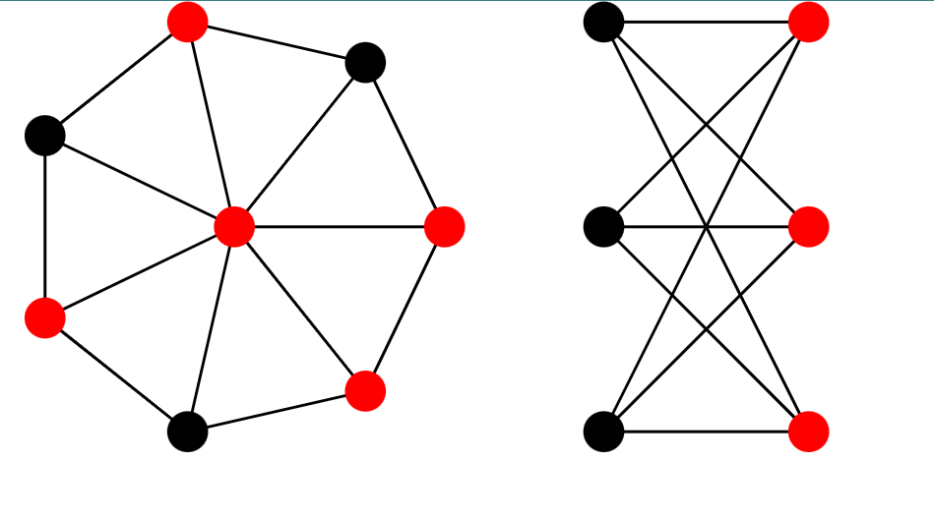
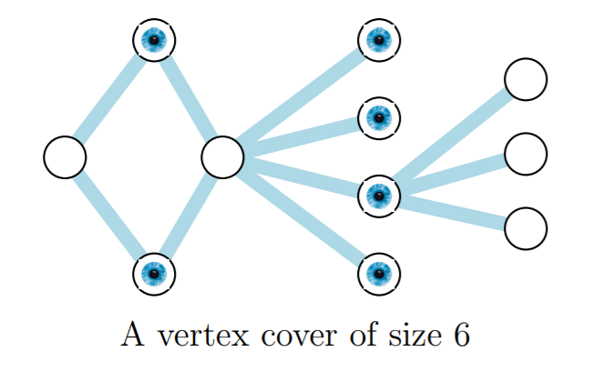
Tractability
Vertex Cover = Given a graph, compute a set of vertices S that include at least one endpoint of every edge.
VC Size = 5
VC Size = 3
Typically, we are concerned about finding the minimum vertex cover
87

Slide 88
Tractability
Finding shortest paths in a distance-weighted graph can be done in polynomial time.
Dijkstra’s Algorithm
88

Slide 89
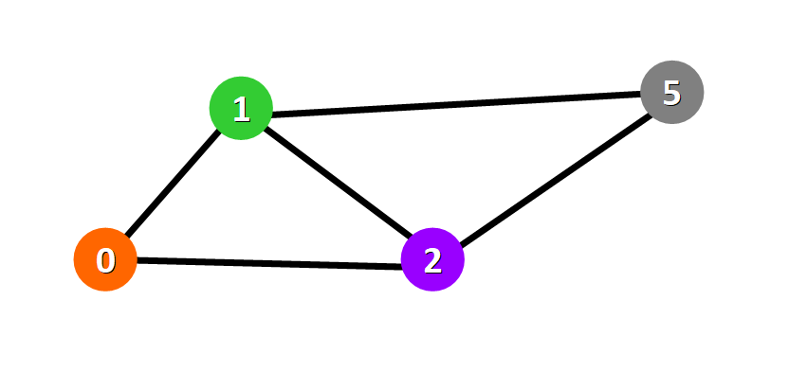
Tractability
Finding shortest paths that cost at most 20 in a distance-and-cost-weighted graph can be done in polynomial time.
12
10
distance
cost
5
3
6
8
7
4
4
3
89

Slide 90
Tractability
Finding shortest paths that cost at most 20 in a distance-and-cost-weighted graph can be done in polynomial time.
12
10
By making a small tweak to this problem, this problem actually becomes much more challenging (NP-C)
distance
cost
5
3
6
8
7
4
4
3
90

Slide 91
Tractability
Tractability refers to the problems we can solve and not solve in polynomial time
NP
P
NP-Complete- The hardest problems of NP. If we can solve one NP-Complete problem, we can solve all other NP-Complete problems
sorting
NP Complete
Shortest path
Fractional knapsack
Traveling Salesman
Closest pair of points
0-1 Knapsack
Rod cutting
Change making
3-SAT
and much more
Vertex Cover
Vertex Cover = Given a graph, compute a set of vertices S that include at least one endpoint of every edge.
91

Slide 92
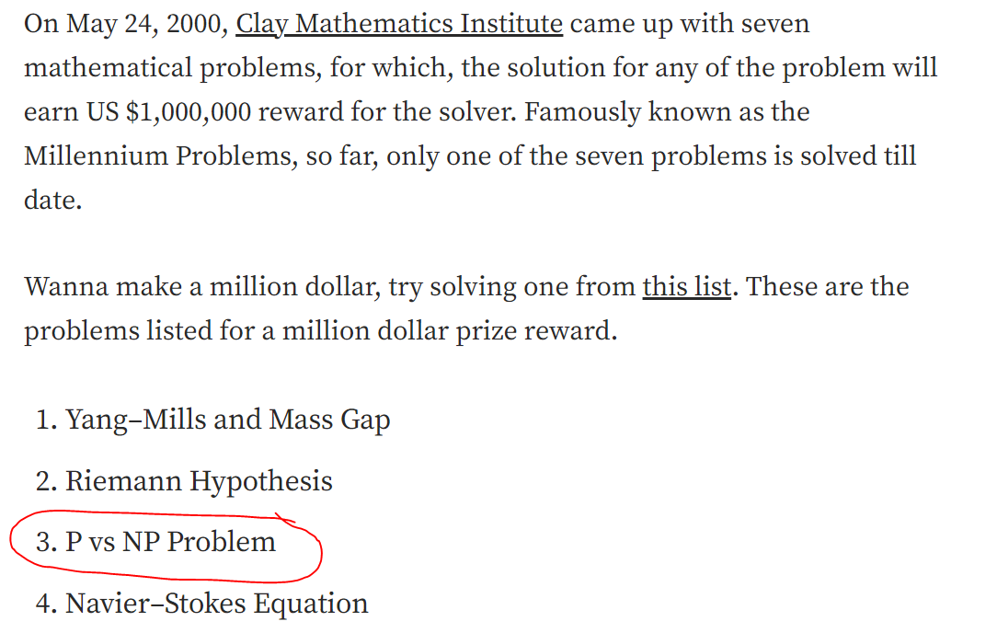
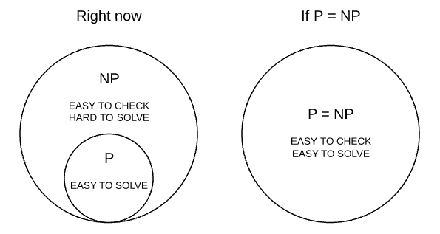

Tractability
If you can solve TSP in polynomial time, you can win a million dollars, probably become a tenured CS professor, and also break cybersecurity
92

